Slide 1
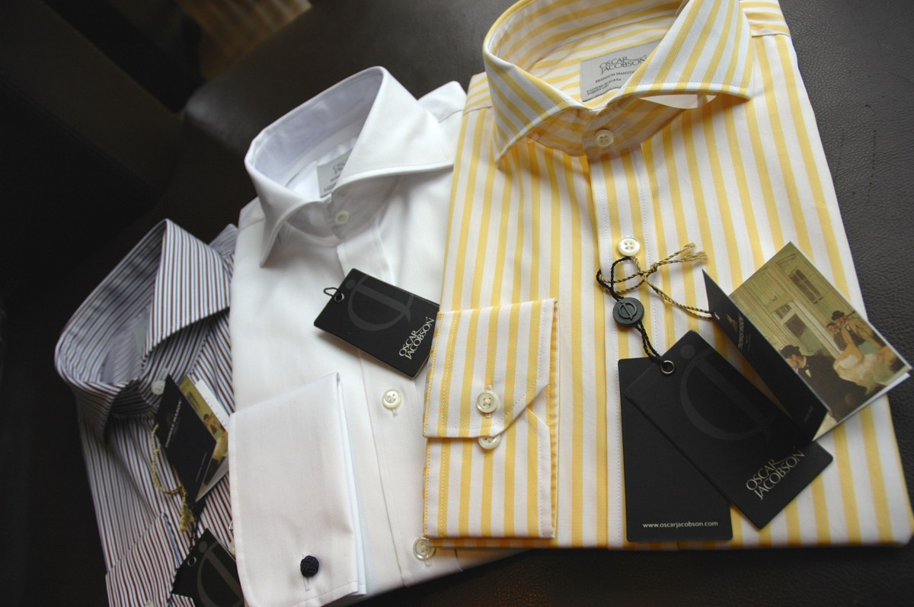
E-COMMERCE PLATFORM FOR MEN’S SHIRT
DAT 310 PROJECT
by
Seth Agbavitor.K and Yemisi Teju Olasoji

Slide 2
LOGO
LOGO
Home
Login/Register
Products
Cart

